Slide 1
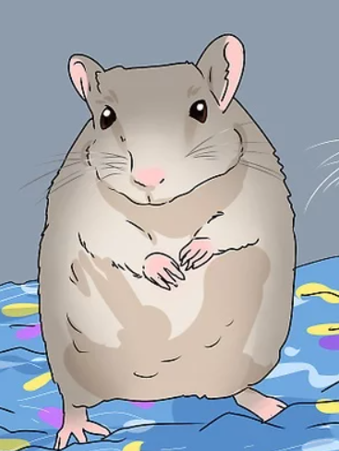
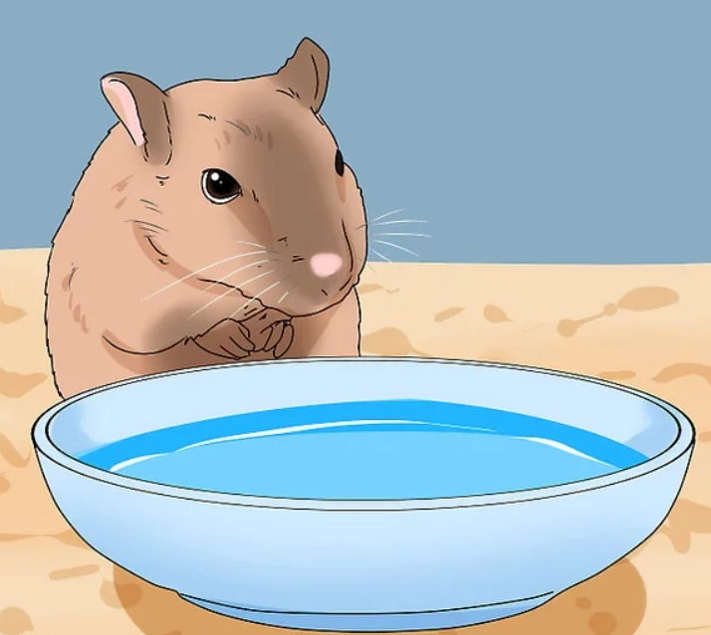
CS311 – Project 3
Ethan Buckner ←My name https://github.com/Smokinghalo8/Project3

Slide 2
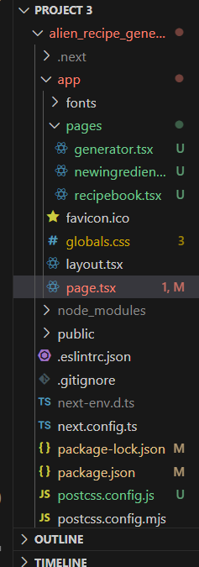
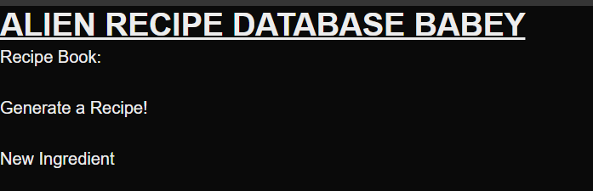
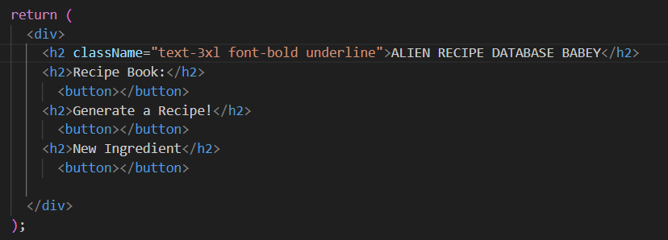
Milestone 1

Slide 3
Milestone 1 – Progress expectations
By this point you should have
Initial database structure –Vercel or a different database?
Page ‘stubs’ for all your pages -Checkeroni
Insert feature for tags –Need to get Vercel or another db going firest
Data validation on the insert pages –Insert Pages still need to be fully made
Some animations –oh yeah B)

Slide 4
Milestone 1 – Discussion Questions
List some difficulties of seeding data
-No difficulties with seeding a database, I loved the file you gave us in an earlier assignment!
Identify some effective animation strategies
-Always add bounce! I’m in an animation class right now and I need to add something similar to my 3D models.
What surprised you about the database design? Did you need to redesign it?
- I need to redesign It definitely, I might use sqlite instead of Vercel again this time around, since Vercel can only allow for one database at a time.
Planning for recipe generation.
-Mad Lib everything, include multiple libraries if we cant include multiple, but multiple would be easier for data manipulation.

Slide 5
Milestone 1 - Reflection
Did you visualize your database design? Why or why not? Did it affect your production?
-Yes I wrote out a basic sketch of how I wanted everything done, and it took a few days to get everything… right.
Where else might visualization affect your ability to plan and produce code?
-If you don’t visualize, you’ll need to go into the css work without any idea of how you want everything to look. That’s like walking into the woods without a flashlight at night.
Having done a fair amount of form work now in React, what things get in the way of your productivity?
How might you solve those issues?
-I would say understanding where everything goes in the code so far, and how exactly app router works. I can solve these by looking them up or by asking the professor how to work them more in class!

Slide 6
Milestone 2

Slide 7
Milestone 2 – Progress expectations
Search page completed – ITP(In the process)
Generating recipes / inserting recipes completed - Check
Further styling / animations – Checkoroni!
Ideally – some questions / problems with this progress –A few snags but pushing through!

Slide 8
Milestone 2 – Discussion Questions
What strategies did you use for generating the string data for the recipes?
Biggest strat I’m using it create a separate database table almost like a madlib using different descriptive words, and a random number generator to choose which word to use!
What is the right DB design for a recipe? Plain text for all steps or another DB model with entries for each step?
Separate Databases for each new adverb or action! For saving the string, put into a separate table in the database, with commas between steps and index that string for steps and such.
What are some animations you could drop into this experience to up the ‘feel’? Check out some examples from https://www.react-spring.dev/examples
I would LOVE to add a quick animation that ‘mixes’ each food item in a pot png on screen? That would be kinda cool!

Slide 9
Milestone 2 – Reflection
Is your application ready for testing? What issues do you anticipate? How can you mitigate those issues being the “major problems” users identify?
I’m anticipating issues with using and running the website on other computers, to get past this issue in my mind, I just need to run the website on other computers before submitting the final!
Have you redesigned your database during production? Why/why not?
No, It may take awhile but I believe the multi database design is a viable solution!
What happens to your database during testing? It is maintainable?
The db can be changed and edited during testing, you can always re-run the seed file.

Slide 10
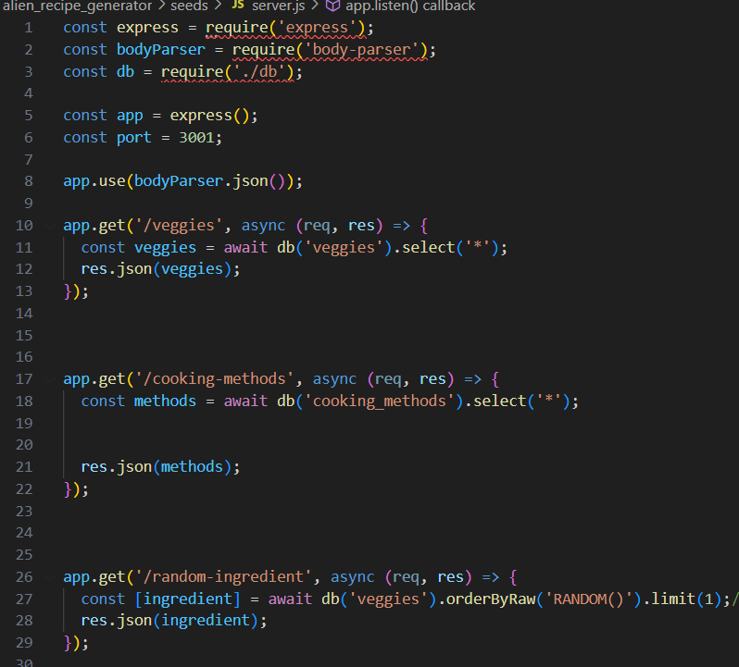
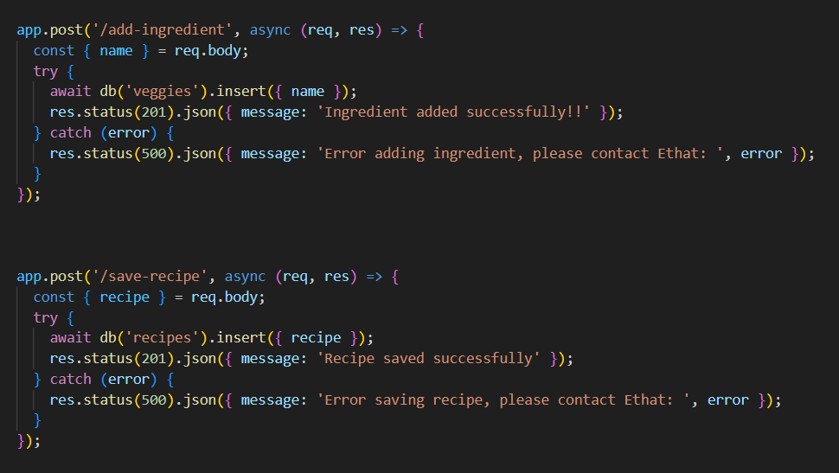
Final Reflection PHOTOS

Slide 11
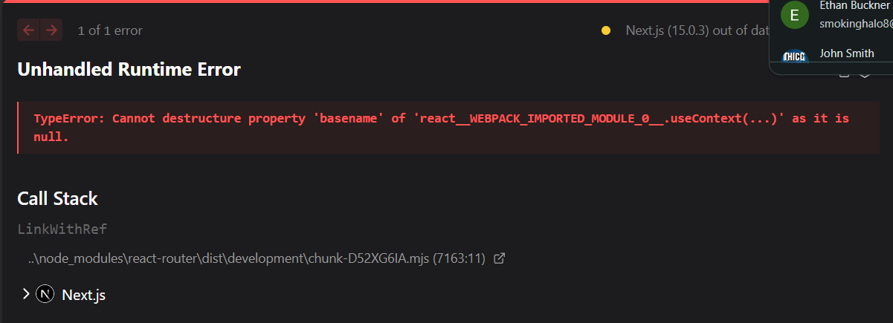
Final Reflection
This Project was another though one, I finished everything except for searching and tags, By the time I tested my application everything became a broken mess and it all fell through because of ONE ERROR, the error being shown above here. I spent more time on this project than I did for any of my other finals and, if you look at my code, you can tell how scuffed it is, but I did my best and I’m proud of it, even if I have a huge error as of now in it. Other than that I had a lot of fun! I loved using tailwind and SQLLite was really cool to learn! Overall 10/10 would code again!

Slide 12
Final reflection
List here several takeaways you had from the process
1 failure / struggle
I completely failed in my own eyes with the animation and page routing portion, prior to adding the newingredient page, I had a pot animation that would take the images of the ingredients and swirl them around before being put behind the pot. But my program kept failing to install framer-motion, kept giving me dependency errors. I tried –forcing it install but even then was refusing to work.
1 success
I LOVED making the SQLLITE databases! I found it fun how they all look the same and they remind me a lot of the command prompt! But, one of my biggest successes on this project was the databases, I correctly and finally got them all working, including the database that holds both the recipe AND the amount of likes correctly, AND prints them all out correctly onto the book.tsx sub-site! {This was he11 to go through, and I spent well over 2 hours just fixing it so it would actually work properly.}

Slide 13
1 tip for future developers
Never give up, no matter how hard things are, no matter how much stuff you need to get done, never give up. The moment you do, you’ll lose who you truly are, and it’s difficult to get back up after that, especially if you’re a CS Major I find.
Believe in yourself, and good things will come. After all, how can anyone believe in someone who doesn’t believe that they themselves can succeed?

Slide 14
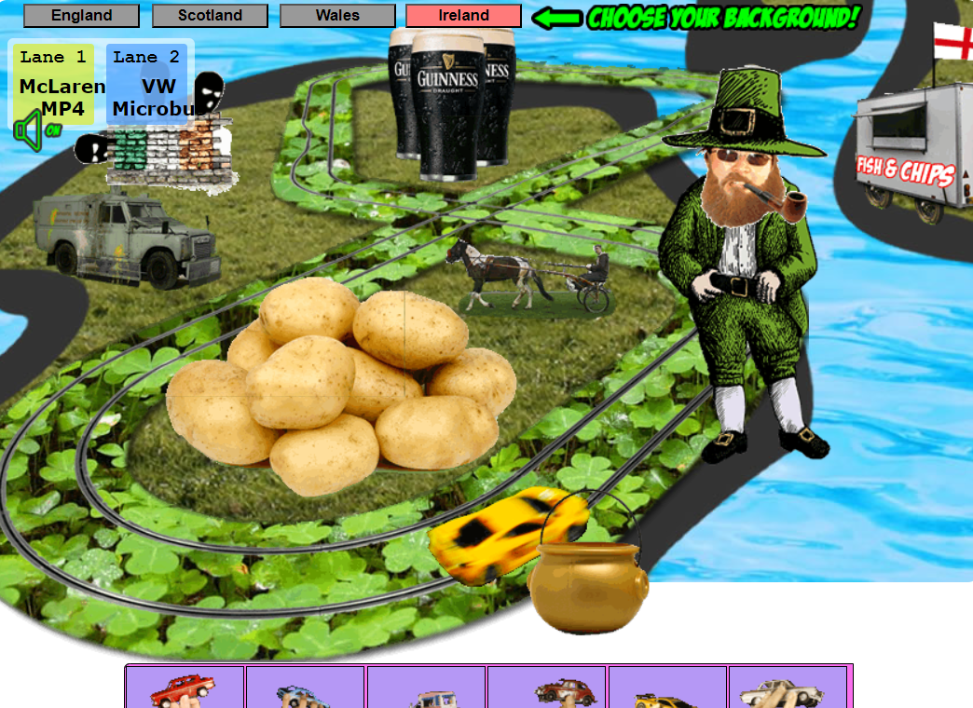

Favorite Activity that was assigned to us::
Has got to be this one with lingscars
In my mind, this is what you see when you drink Skooma from Skyrim

